Slide 1

ScanMasterX Team No 10: UwUltimate Stardust Crusaders

Slide 2





Team Details
Dennis
Eric
Lewis
Alexa
Will

Slide 3
Project Overview
ScanMasterX seeks to lower the barrier of entry to analyzing and understanding the security of a network.
Scans for IP addresses within a network
Scans the ports located at specified IP addresses
Displays the topology of the IP addresses found on a network
Attempts a simple exploit

Slide 4
Requirements List
R1:………….
R2:……….
(Please Be concise)

Slide 5
Project Solution Approach
What are the major components in your solution design?
Is it a web framework?
Is it a mobile application?
Having next slide be an image/drawing of your structure would be great
What are the tools, frameworks, platforms, libraries, etc. that you’ll be using
Note one or two that are key to your solution
Is there any key reason why you’re using a given technology?
There’s not a long time here to do compare and contrast, but a few key words about why you picked the system that you did will be appreciated

Slide 6
System Architecture Diagram

Slide 7
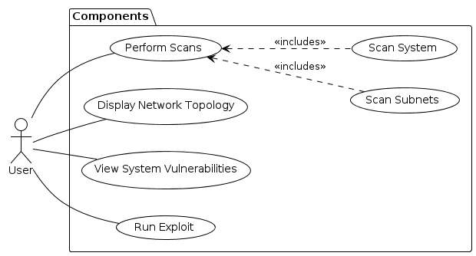
Use Case Modeling

Slide 8
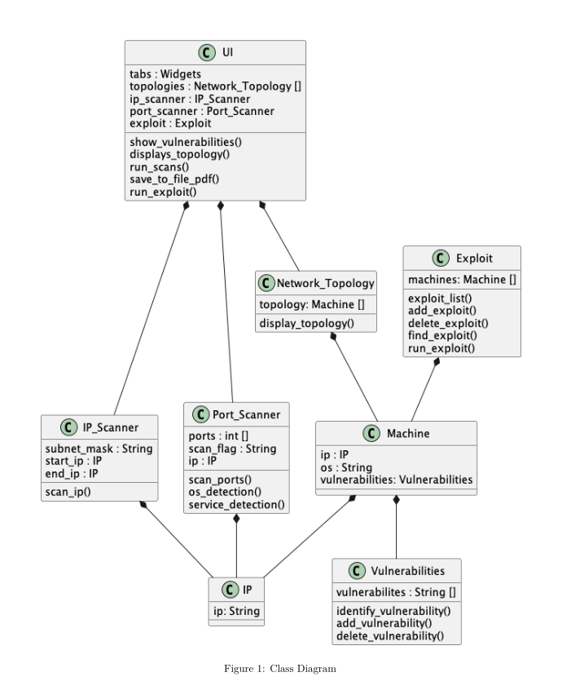
Structural Modeling: Class Diagram

Slide 9
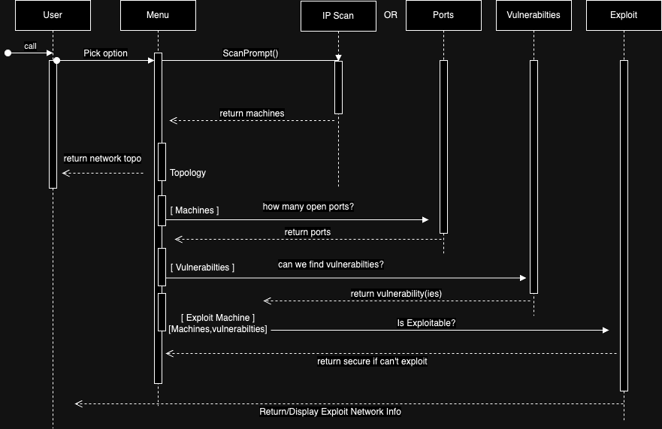
Behavioral Modeling: Sequence Diagram

Slide 10
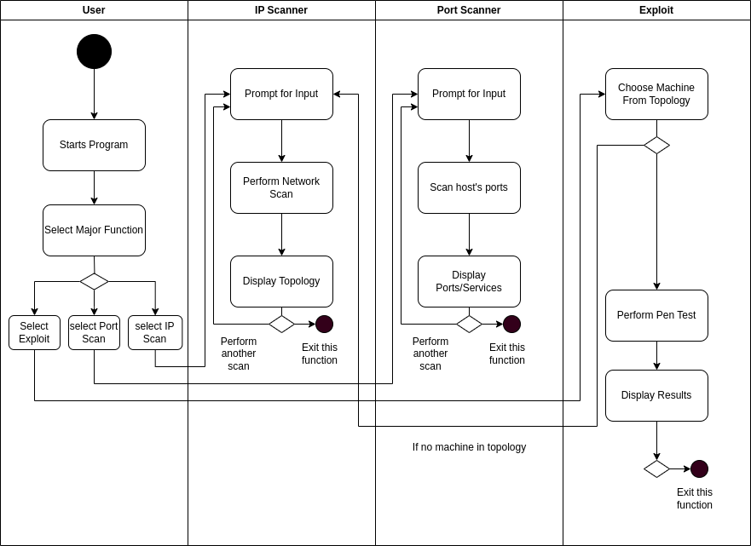
Behavioral Modeling: Activity Diagram

Slide 11
Screenshots (UI, Code, if any)

Slide 12
What Next??

